Slide 1
CMSC 426 Principles of Computer Security
Wireless Hacking and Security

Slide 2
Last Class We Covered
Important info you need to know
Cookies
HTML
GET and POST
JavaScript
Cross-Site Scripting
SQL Injection

Slide 3
Any Questions from Last Time?

Slide 4
Today’s Topics
802.11 Standard
Basic information
Sessions and security
Wireless Hacking

Slide 5
802.11 Standard

Slide 6
802.11 Standard
Specification for how WLANs are implemented
Wireless Local Area Networks
Provides the basis for Wi-Fi technology
Standard put out by IEEE
802 covers anything dealing with area networks (local or metro)
11 is specifically for WLANs
Multiple amendments have been released, including a, b, g, and n
Information from Hacking Exposed 7 (McClure, Scambray, Kurtz)

Slide 7
802.11 Frequencies and Channels
802.11 operates within the radio spectrum, specifically the industrial, scientific, and medical (ISM) radio bands
Can operate in 2.4-GHz or 5-GHz ISM bands
Each spectrum is divided up into channels
2.4-GHz is channels 1-14, which overlap slightly with their neighbors
Overlapping can cause interference, but 1, 6 and 11 are non-overlapping
5-GHz is channels 36-165 (in the US) and they don’t overlap
Information from Hacking Exposed 7 (McClure, Scambray, Kurtz)

Slide 8
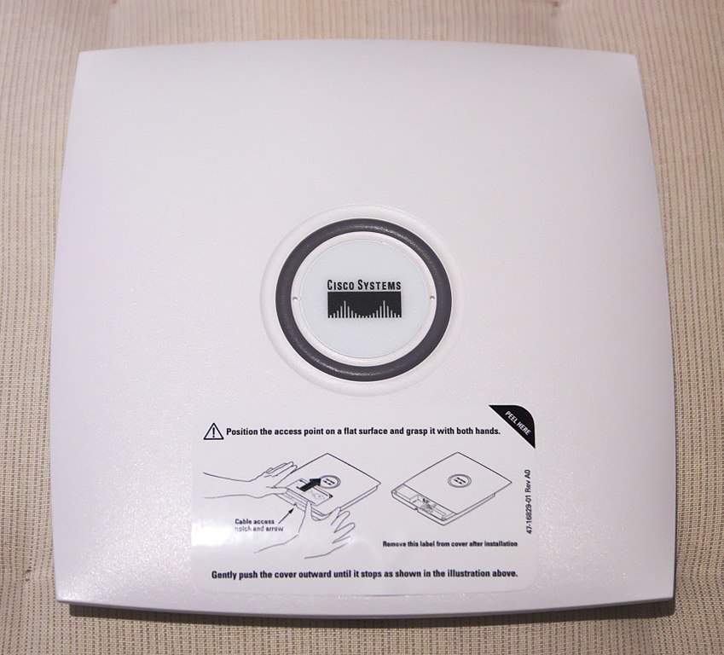
Wireless Access Point
Hardware device that allows a Wi-Fi device to connect to a wired network
Connected directly to a WLAN, typically Ethernet
Access point provides wireless connections so that other devices may use the wired network
Multiple wireless devices can connect thru a single wired connection
Networks with access points are referred to as infrastructure, while those that are peer-to-peer are called ad hoc
We’ll be focusing on infrastructure networks

Slide 9
Service Set Identifier
Also known as SSID
The network’s “name,” often set by the network admin
UMBC has eduroam, UMBC Campus, and UMBC Visitor
Possible to have two networks with the same SSID within the same broadcasting range
Some devices try to connect to the one with the stronger signal
Some devices try to connect to the first one they see

Slide 10
802.11 Sessions and Security

Slide 11
Establishing an 802.11 Session
Before establishing a connection, client must identify if a wireless network is actually present
Sends out a probe request asking the network to identify itself
Uses SSID, and broadcasts on each channel it supports
If present, access point (AP) responds with a probe response
Next, client sends out an authentication request
Separate from any security measures or encryption
Most APs are configured to accept any connection, and will only reject the connection when incorrectly encrypted data comes through
Information from Hacking Exposed 7 (McClure, Scambray, Kurtz)

Slide 12
Establishing an 802.11 Session (Continued)
Final step is an association request, sent by the client
Begins the record-keeping process of association
AP sends out an association response
Indicates that the AP is keeping track of the wireless client
At this point, client should be able to communicate with AP
Depending on the level of security, may require further steps
Information from Hacking Exposed 7 (McClure, Scambray, Kurtz)

Slide 13
802.11 Security Mechanisms
MAC filtering
Some APs will deny a client connection if their MAC address does not match an address in a preconfigured list
“Hidden” wireless networks
APs send out beacon announcements with info on connecting
Beacon may be configured so that SSID is omitted
Client cannot join the network without knowing the SSID
Ignoring broadcast probe requests
Clients can discover nearby wireless network through a broadcast probe request, without knowing the SSID; simply ignore these
Information from Hacking Exposed 7 (McClure, Scambray, Kurtz)

Slide 14
Security Protocols
WEP (Wired Equivalency Privacy)
Uses RC4, a stream cipher
40-bit encryption key, 24-bit initialization vector
Really small size, makes it easy to crack!
WPA (Wi-Fi Protected Access)
Interim standard released because WEP was so flawed
Also uses RC4, but with a 256-bit key, and a 48-bit IV
Adopted TKIP (Temporal Key Integrity Protocol) to increase security
Generates a new 128-bit key for each packet
Information from https://searchnetworking.techtarget.com/feature/Wireless-encryption-basics-Understanding-WEP-WPA-and-WPA2

Slide 15
Security Protocols (Continued)
WPA2 (Wi-Fi Protected Access 2)
Current standard
Uses AES-CCMP instead of TKIP
TKIP was designed to not have additional hardware requirements
AES: Advanced Encryption Standard
CCMP: Counter Mode Cipher Block Chaining Message Authentication Code Protocol
CCMP allows only authorized network users to receive data, and uses cipher block chaining MAC to ensure message integrity
WPA2 can also use TKIP as a fallback if CCMP isn’t supported
Information from https://searchnetworking.techtarget.com/feature/Wireless-encryption-basics-Understanding-WEP-WPA-and-WPA2

Slide 16
Wireless Hacking

Slide 17
Wireless Hacking: aircrack-ng suite
Software suite of tools to assess Wi-Fi network security
Contains WEP and WPA crackers
Allows monitoring and capture of transmitted packets
Can be used to perform attacks
Replay, de-authentication, fake access points, packet injection, etc.
Available on the Kali Linux VM!
Information from https://en.wikipedia.org/wiki/Aircrack-ng and https://www.aircrack-ng.org/

Slide 18
Wireless Hacking: Sniffing Traffic
Many networks are unencrypted at the 802.11 layer
Makes it trivially easy to “sniff” transmitted packets, listening in
Note: depending on local laws, this may be straight-up illegal
Wireshark is a packet analysis tool for live or captured data
Simplest defense is to enable an 802.11 layer encryption
If that’s not possible, higher level encryption can also be used
Information from Hacking Exposed 7 (McClure, Scambray, Kurtz)

Slide 19
Wireless Hacking: De-Auth. Attacks
Spoofs de-authentication frames from the client to the AP and vice versa to force a disconnect
May send multiple frames, as some clients try to reconnect immediately
Can use the aireplay-ng tool (within aircrack-ng) to perform this
Sends out 128 frames (64 to client, 64 to AP) for every deauth
Difficult to thwart without going outside the 802.11 standards
As a solution, some drivers will disconnect and quickly try to reconnect elsewhere when they see a de-auth frame, but this can be countered
Information from Hacking Exposed 7 (McClure, Scambray, Kurtz)

Slide 20
Wireless Hacking: WEP Cracking
Good demonstration and explanation:
https://youtu.be/RydsjNhUjdg
Information from Hacking Exposed 7 (McClure, Scambray, Kurtz)

Slide 21
Wireless Hacking: Wardriving
Driving around, using a laptop or smartphone to search for Wi-Fi wireless networks
Can be used to map out the location of networks
Seattle was mapped by 100 undergrads in 2004, who found 5200 access points, including one called “Open to share, no porn please”
There’s also warbiking and warcycling, but it’s not as cool sounding
Wardriving is technically legal, although when Google admitted to doing it with the StreetView vans, people weren’t happy
It’s okay – they just use your Android mobile device to do it now
Information from https://en.wikipedia.org/wiki/Wardriving

Slide 22
Wireless Hacking: Wi-Fi Pineapples
https://youtu.be/I4f47q7fNZk

Slide 23
Image Sources
Wireless access point:
https://en.wikipedia.org/wiki/File:Cisco_Aironet_1131AG_-_Close.jpg

